Slide 1

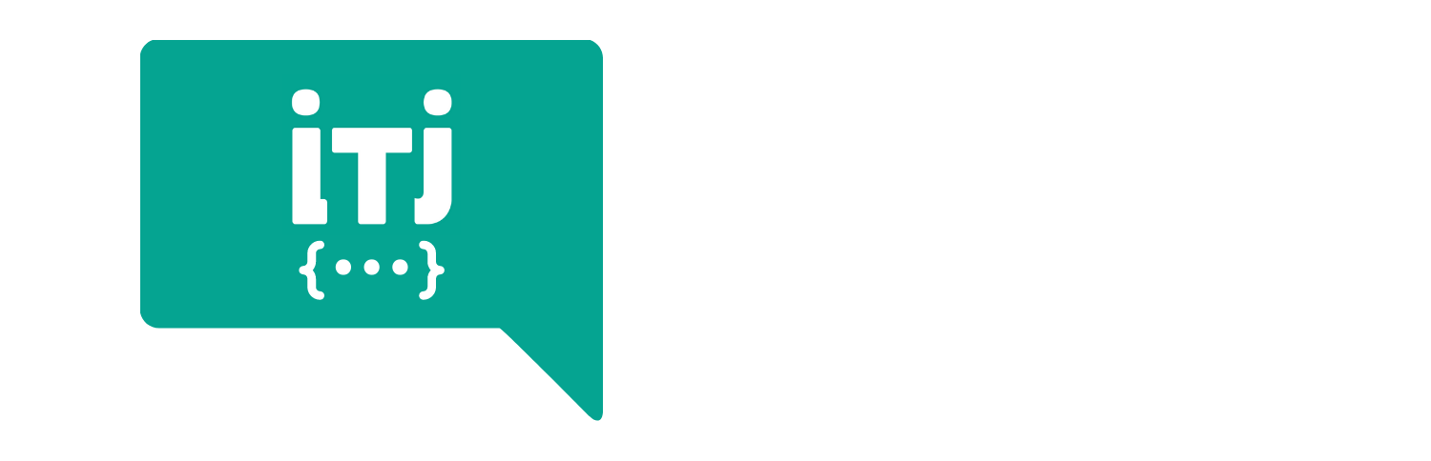
DevOps Bootcamp

Slide 2

HELLO!
I am Noothan Shah
I am here because I am passionate about DevOps.

Slide 3
“The more you learn, the less time you take to learn more”

Slide 4
Agenda
DevOps Lifecycle
DevSecOps
DevOps Roadmap

Slide 5
DevOps Lifecycle

Slide 6
Software Development Lifecycle
Plan
Release
Code
Deploy
Build
Operate
Test
Monitor

Slide 7
DevOps Lifecycle Phases
Plan
Release
Continuous Development
Continuous Deployment
Code
Deploy
Build
Operate
Continuous Testing
Continuous Monitoring
Test
Monitor
Continuous Integration
Notes:
Continuous Development
Version control systems - git
Team of developers - git branches
Continuous Testing :
Code checkin → build & test
Continuous Deployment:
Test passed →

Slide 8

Thoughts !
Time Consuming
Error Prone
Repetitive Work
Inconsistency
Dependency

Slide 9
Cont. Integration & Cont. Delivery
Plan
Code
Build
Test
Release
Deploy
Operate
Monitor
Continuous Integration
Continuous Deployment

Slide 10
CI/CD Pipeline
Fast
Efficient
No Manual Effort
All set to deploy to PROD
Developer checks in code
Automated Tests
Build
Deploy
TEST
Automated Tests
Deploy
PROD ?

Slide 11
DevSecOps

Slide 12
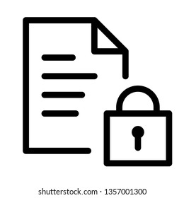




What about Security?
Any application which has sensitive data needs to be secured / protected from security breaches
Banking application / Social Media Apps / Online shopping app
Security breach = compromising sensitive data = loss of business

Slide 13

Security Check towards end
Developer checks in code
Security Checks
Automated Tests
Build
Deploy
TEST
Automated Tests
Deploy
PROD

Slide 14
Security Checks
Security team checks for any vulnerabilities
Finds issues, gives back to Dev team to fix it.
But, by this time because of the super efficient CI/CD pipeline, we have more versions of app available and all waiting for release.
Now that is a problem!!

Slide 15
Shift left - DevSecOps
DEV
OPS
SEC
Developer
Operations
Security
Developer checks in code
Automated Tests
Build
Deploy
TEST
Automated Tests
Deploy
PROD
Sec
Sec
Sec
Sec

Slide 16
In Practice
Pre-commit hooks
Software Composition Analysis (SCA)
Static App Security Testing ( SAST)
Dynamic App Security Testing ( DAST)
Security in Infrastructure as code
Secret Management

Slide 17
DevOps Roadmap

Slide 18

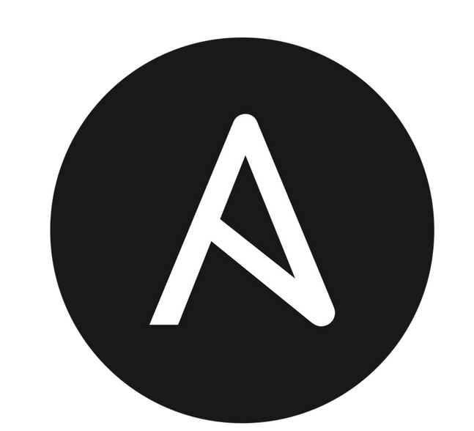


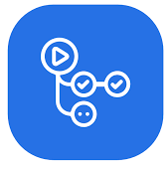


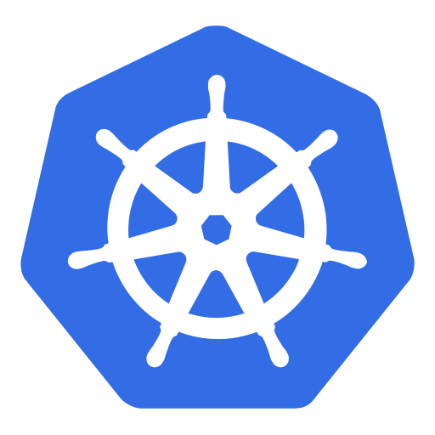


DevOps Roadmap
What DevOps Concepts and Tools to learn ?
DEVOPS ROADMAP

Slide 19
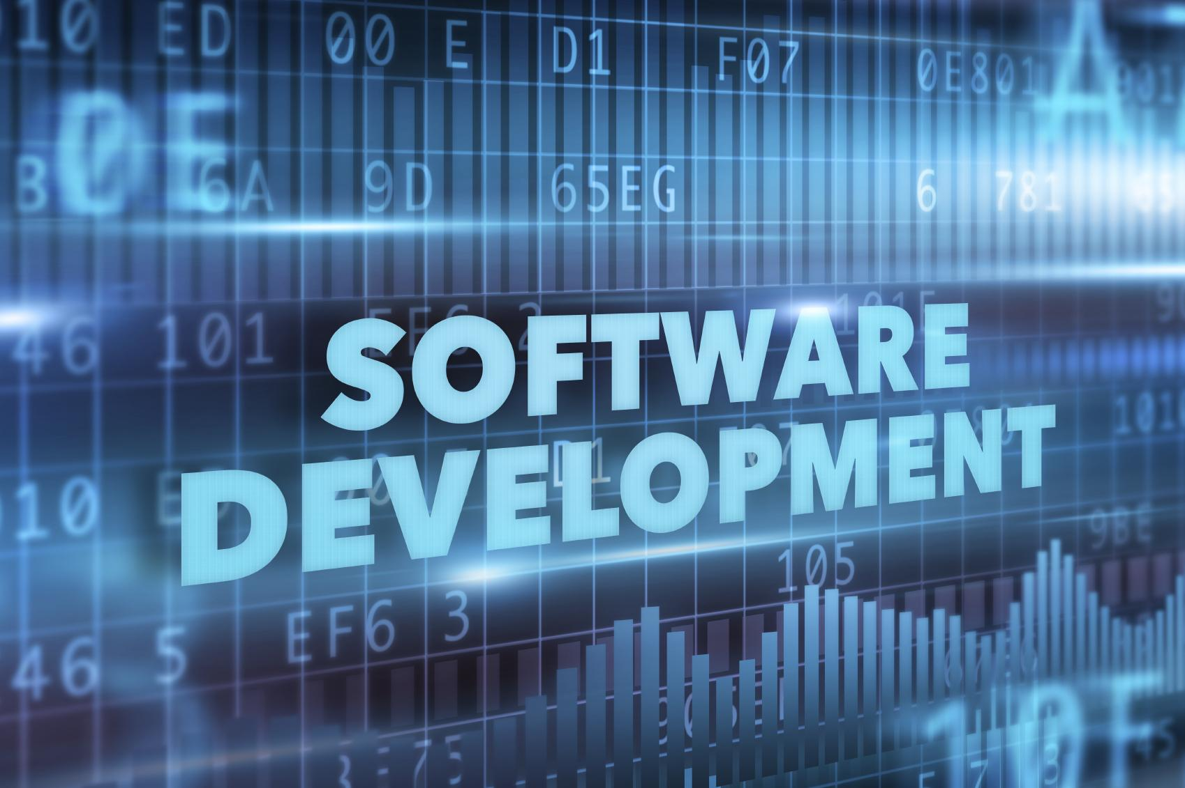

Concepts of Software Engineering
How developers work
How application is configured
Automated Testing

Slide 20
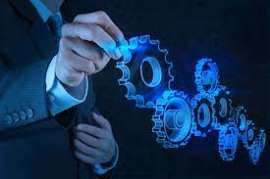
Operating System and Linux Basics
Linux Basics
Comfortable using CLI
Shell Commands
Linux File System
Server Management

Slide 21

Networking and Security
Firewall, Proxy Servers
Load Balancers
HTTP / HTTPS

Slide 22
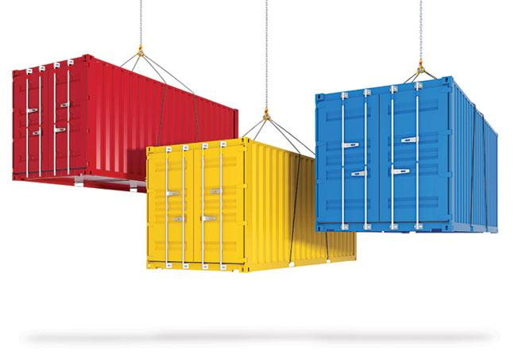
Containers
Virtualization
Containers

Slide 23
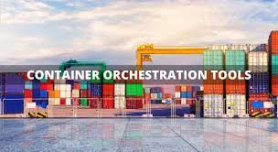
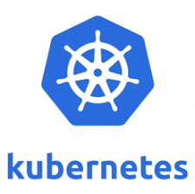

Container Orchestration
Container Orchestration

Slide 24
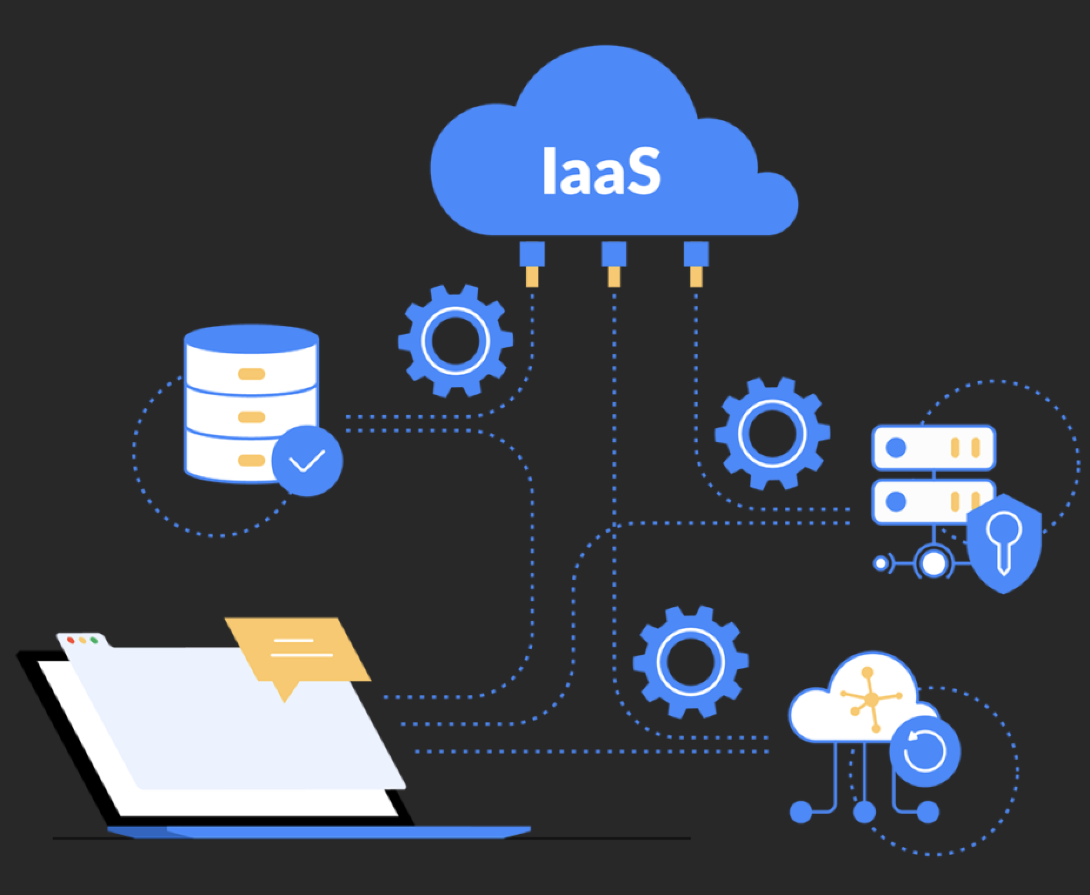


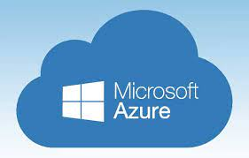
Cloud Providers
Infrastructure as service

Slide 25
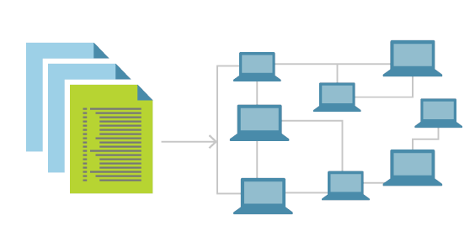




Infrastructure as Code
Infrastructure Provisioning
Configuration Management

Slide 26
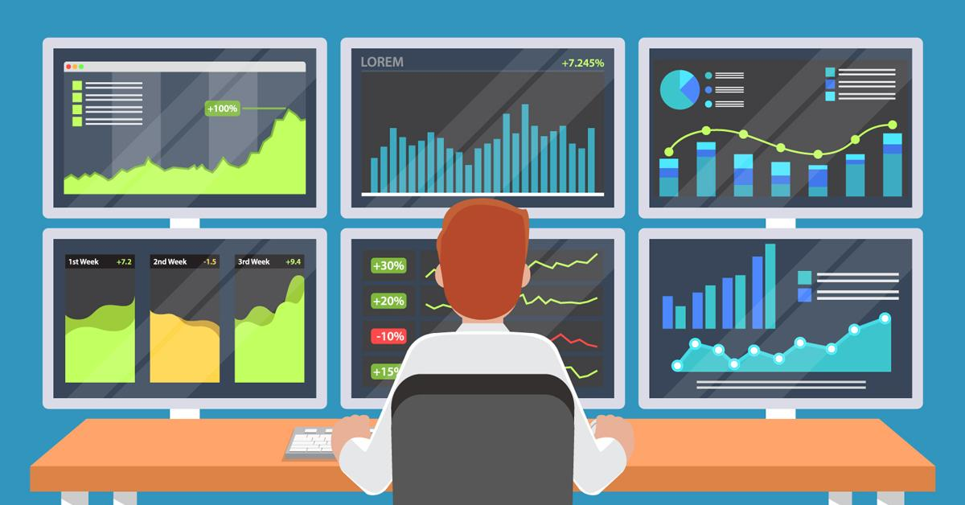



Monitoring
Monitor Software
Monitor Infrastructure

Slide 27
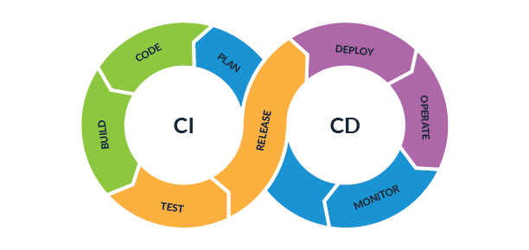
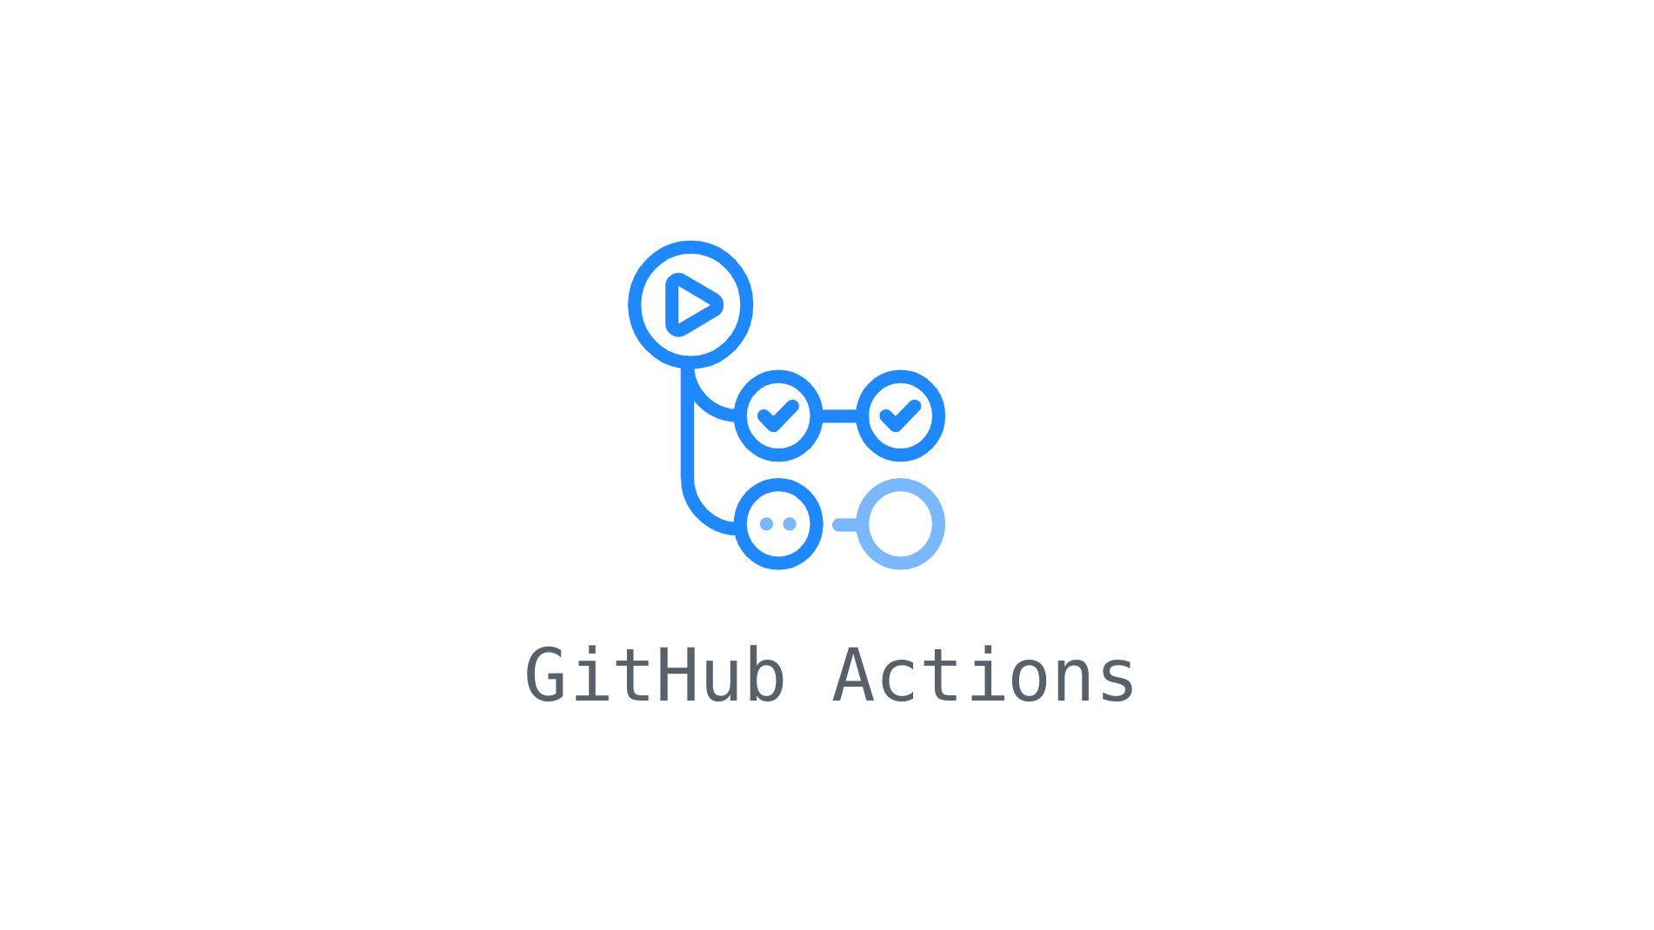


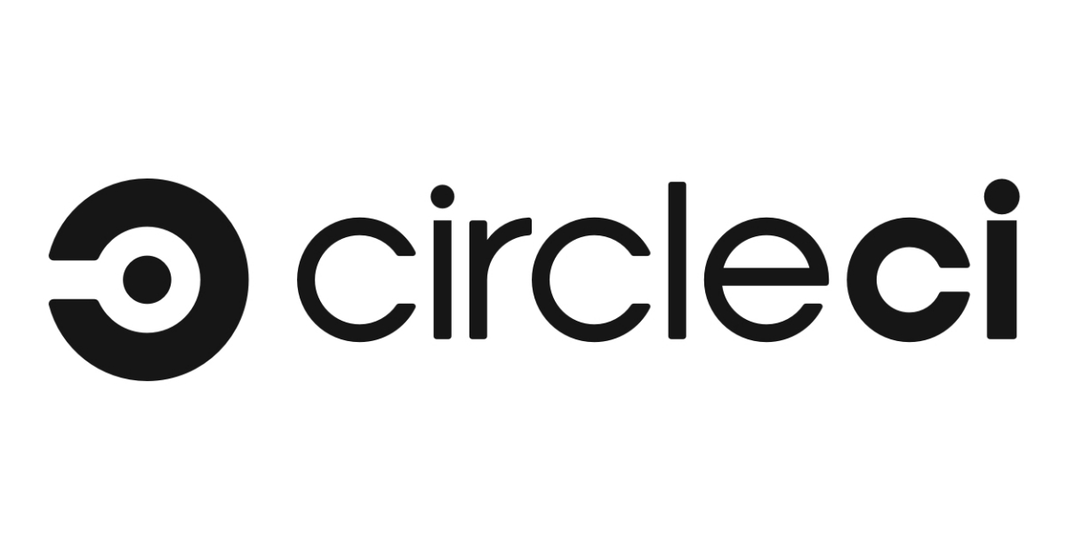
CI/CD
How to configure CI/CD Pipeline

Slide 28
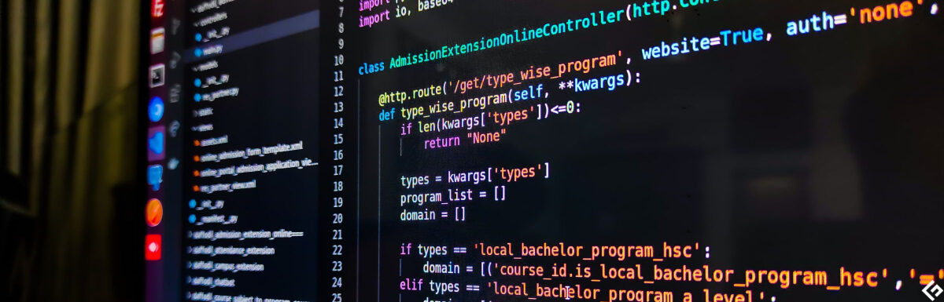

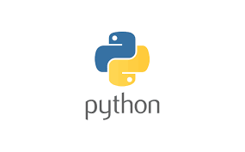


Scripting Language
OS Specific
OS independent

Slide 29
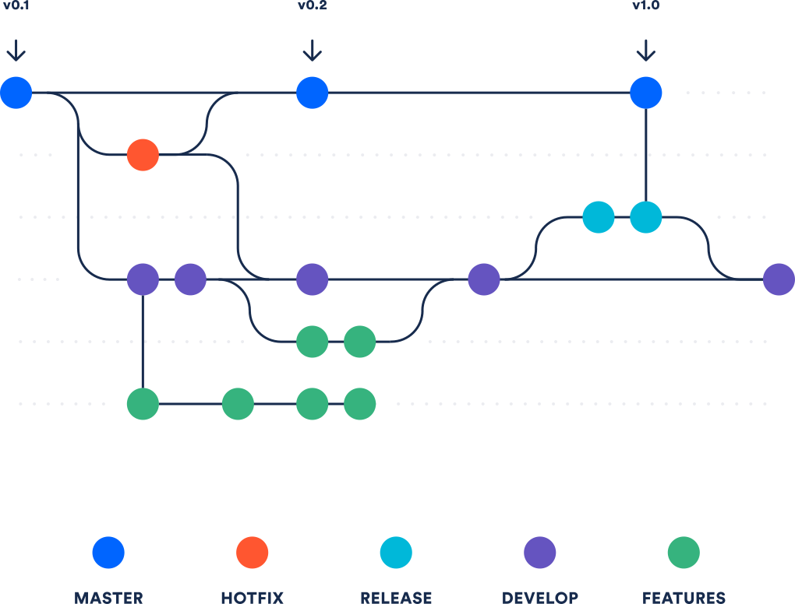
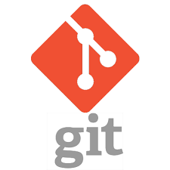

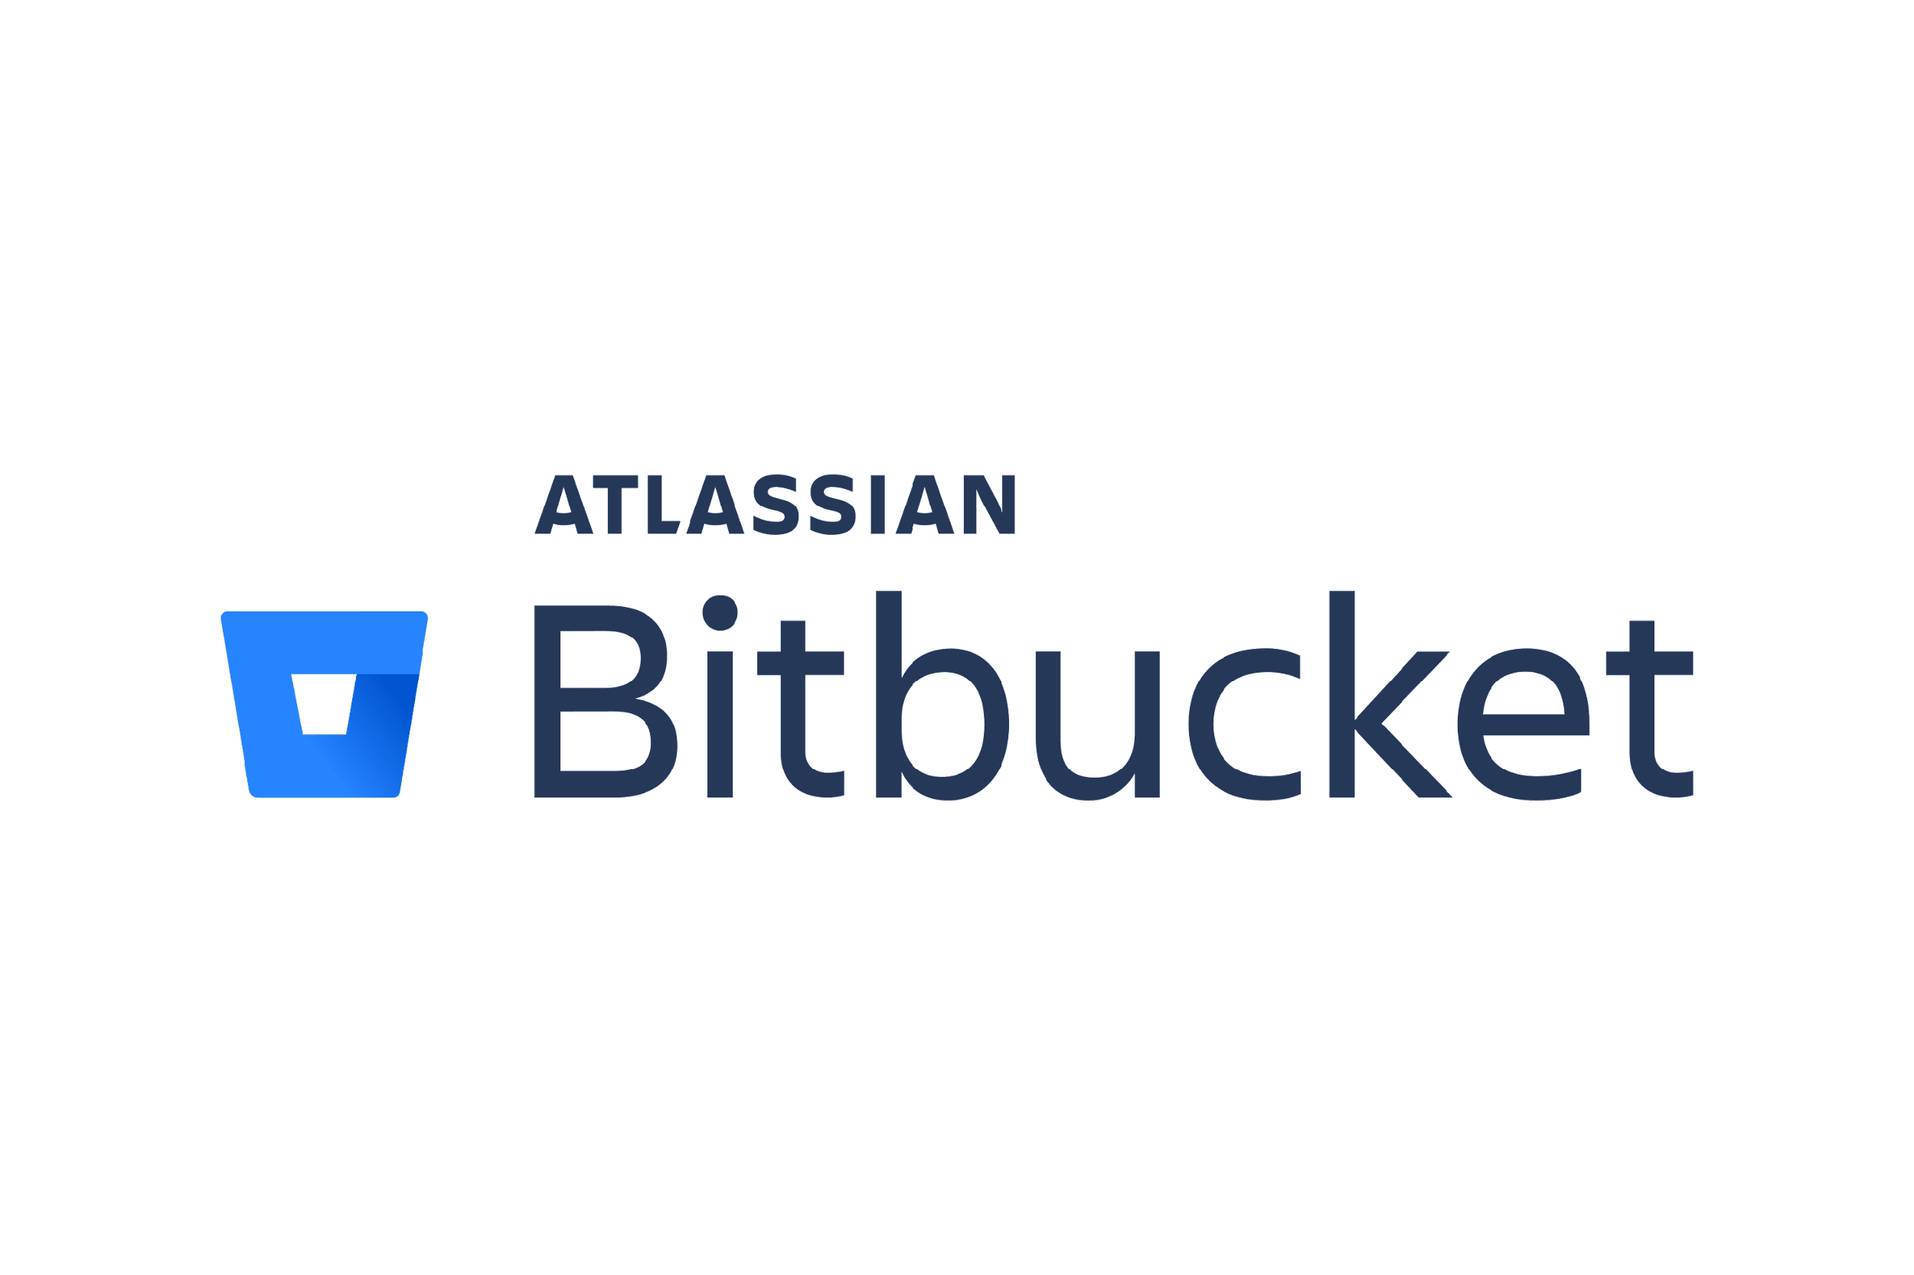

Version Control
Version Control
Version Control Repositories

Slide 30
Thoughts !
Too many tools , which ones to learn ?

Slide 31

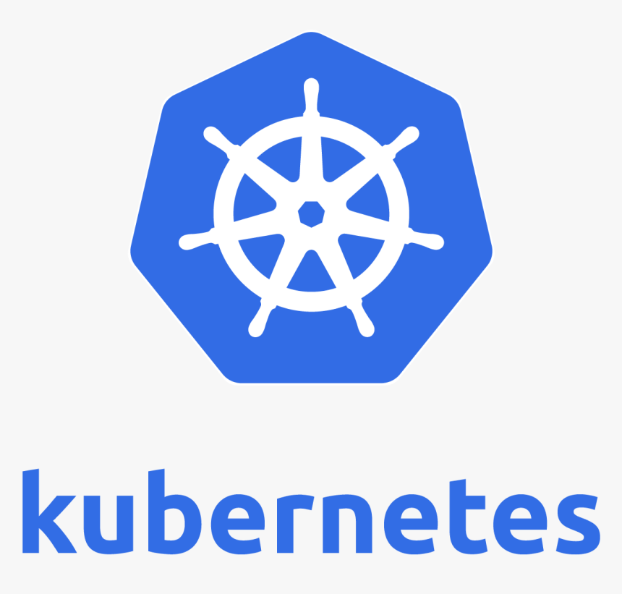


What to learn – in a nutshell
One Tool in each category
Widely used
DEV Concepts
OS Systems & Linux Basics
Networking & Security
CI/CD
Cloud Providers
Scripting Language
Containers
Container Orchestration
Monitoring
Infrastructure as Code
Version Control

Slide 32

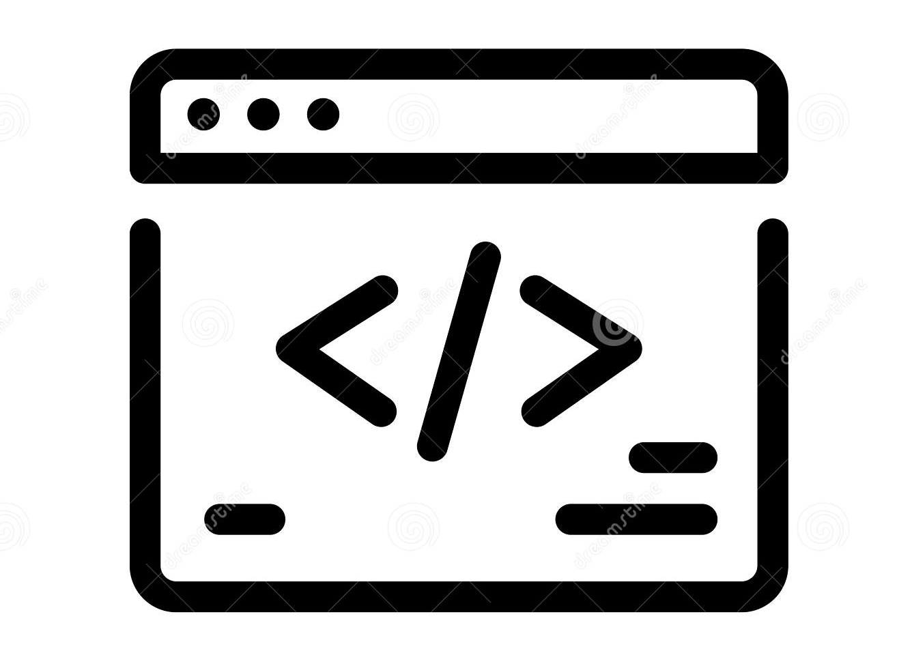








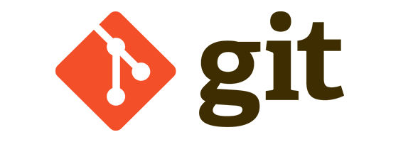
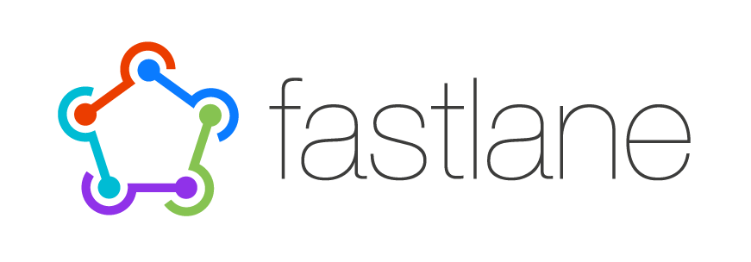







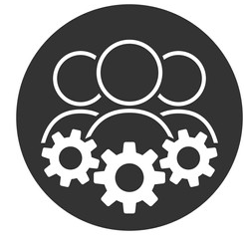




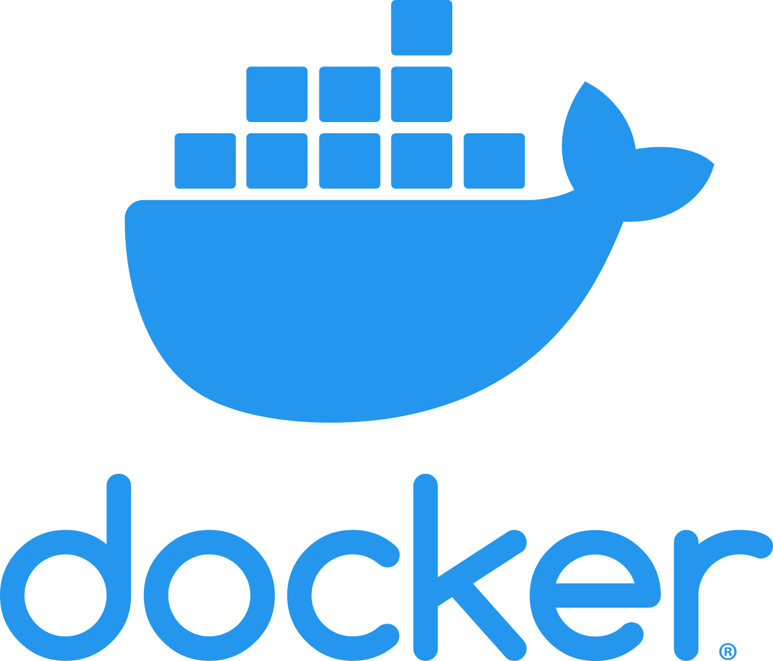


Summary
SECURITY
Continuous Development
Continuous Testing
Continuous Deployment
Continuous Monitoring
DEV
Infrastructure
OPS

Slide 33



Thoughts !
That’s way too much to learn !!
We are here to help ☺

Slide 34
THANKS!
Any questions?
You can find me at work.noothanshah@gmail.com

